Slide 1
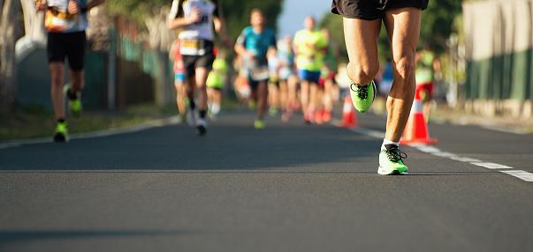

Bib Sense
Team 11 : CMPE 272
Adarsh Narasimha Murthy
AJ Dela Cruz
Di Chen
Sachith Gandham

Slide 2


Slide 3
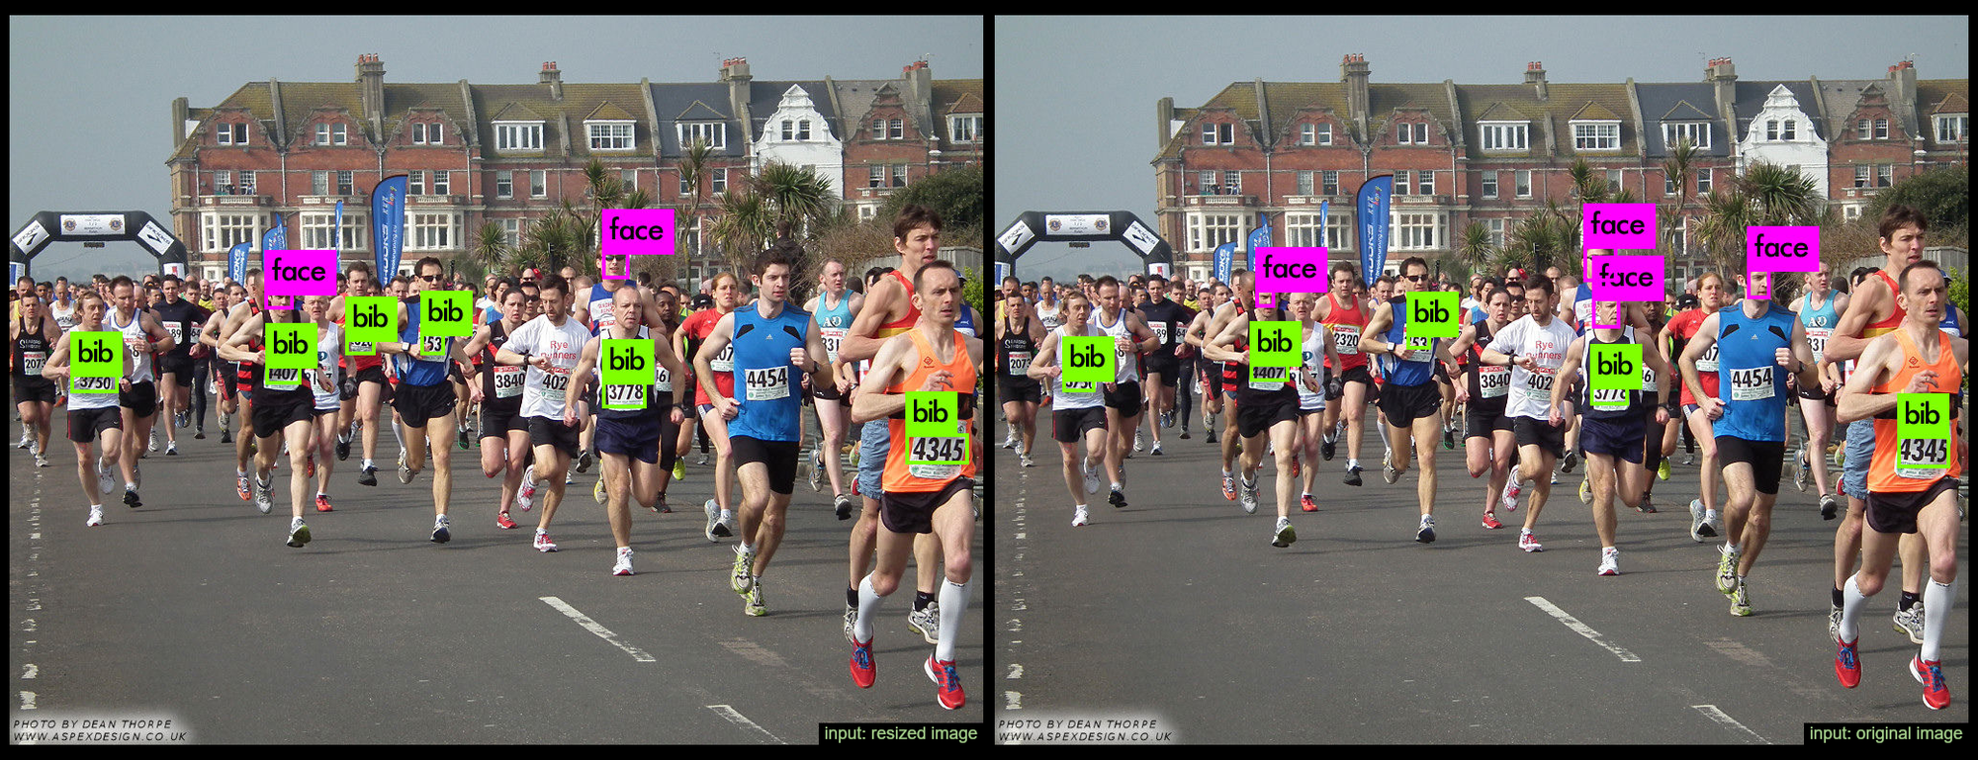
What is Bib Sense ?
BibSense is a viable solution for sport event photographers to generate E-commerce. By selling the pictures, they click during the sporting events the photographers can generate a new channel for their income.
BibSense embraces the benefits that are put forth by Machine Learning. By using the Image processing BibSense revolves the major hassle of identifying the person in the pictures with their details.

Slide 4
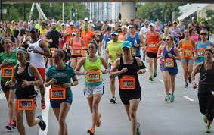
Introduction
BibSense is an automatic system for runner’s bib number recognition in natural image collections covering sporting events such as marathons.
A runner’s Bib is typically a piece of durable paper bearing a number as well as the event/sponsor logo. The Bib, usually pinned onto the shirt, is used to identify the runner among thousands of others during the event.
Our system receives a set of natural images taken in the sports events and outputs the all participants’ bib number present in each image, which is in turn used to map it with the Runner personal details from the registration database. These Images can now be directly accessed by the Runner and would be available at a cost in order to be downloaded by the runner.

Slide 5
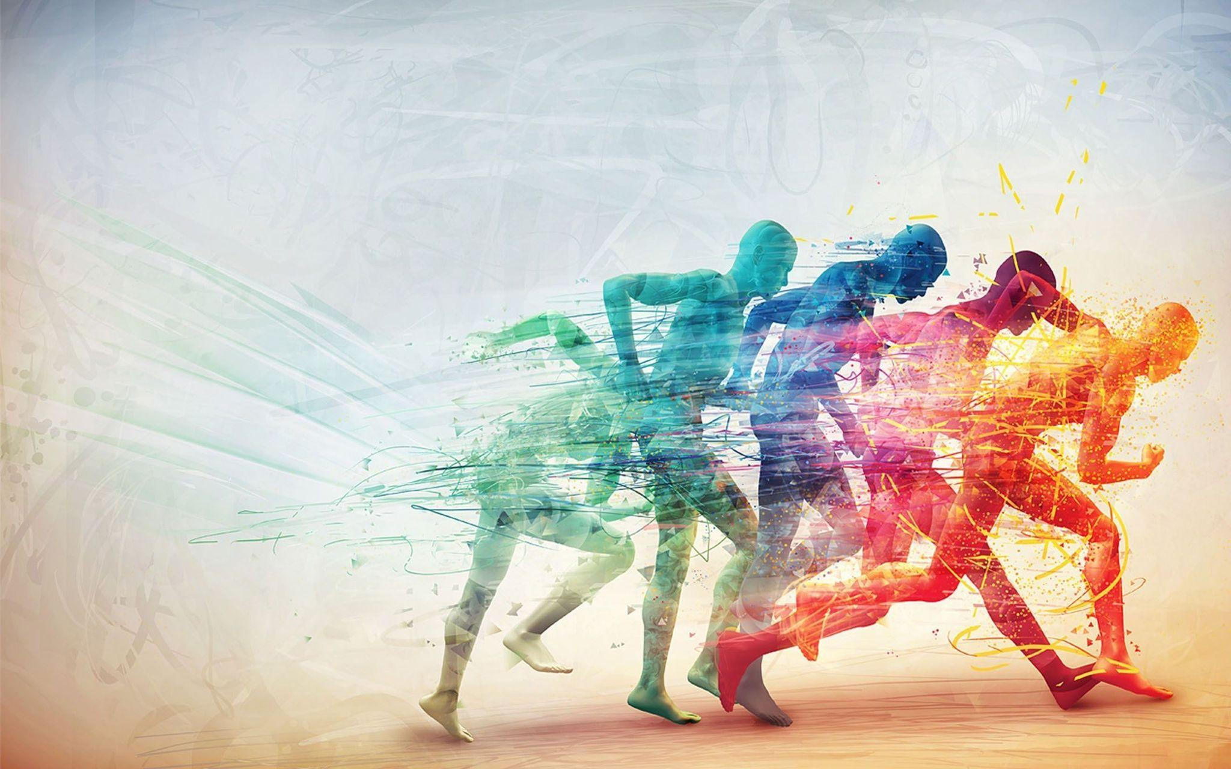
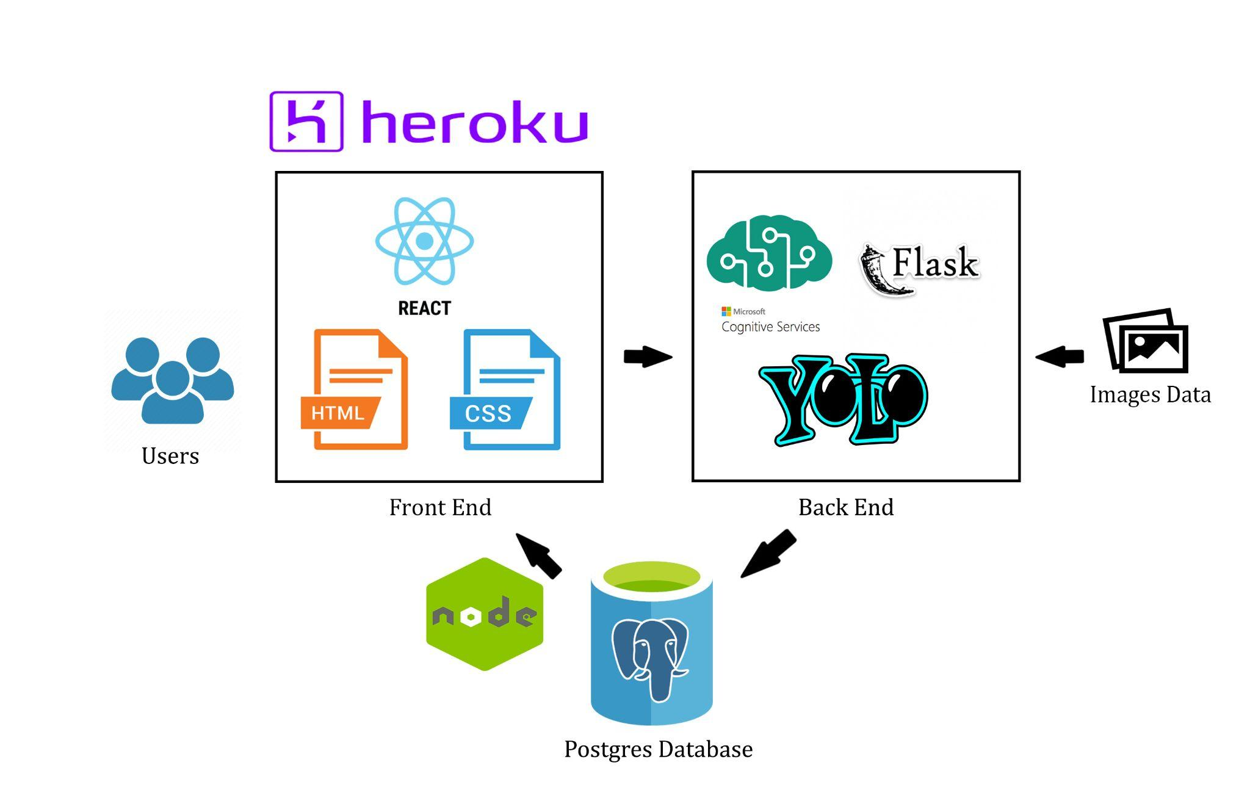
Architecture

Slide 6
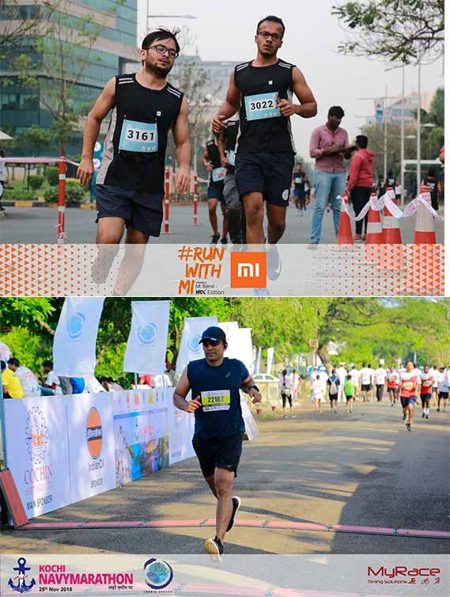
Dataset
The dataset for this project consisted of images from a marathon event. We collected 1500 jpg images taken from various angles with a resolution of 1600*1027 pixels from two marathon events held in India. The image gathered for our dataset has at least one visible racing bib that is mostly not obstructed by any other obstruction.
We split the dataset into two types of annotation, for racing bib detection and numerical digit detection. We define the name of the class object in a text file named “class.txt” in each dataset directory. For racing bib detection, we annotated each image with class and bounding box over a fully identified and obstructed racing bib.

Slide 7
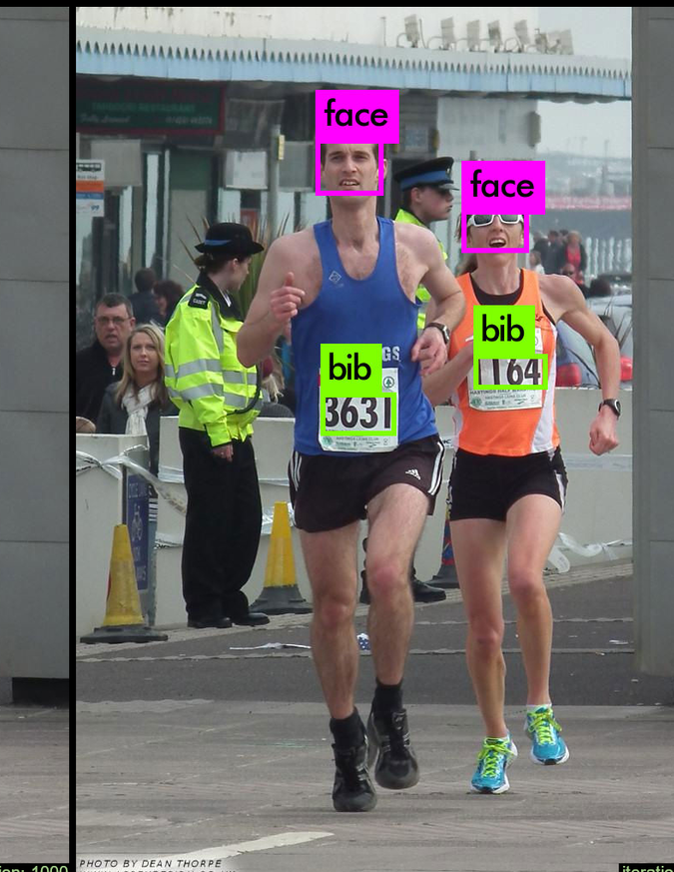
Methodology opted
Built the object detection model based on the YOLOv3 algorithm to solve the bib recognition problem.
On Successful object detection of a Bib number board
Fed the crop object identified from the image which is the Bib plate of the runner to EasyOCR to generate the numerical equivalent of the number being worn on the Bib .

Slide 8
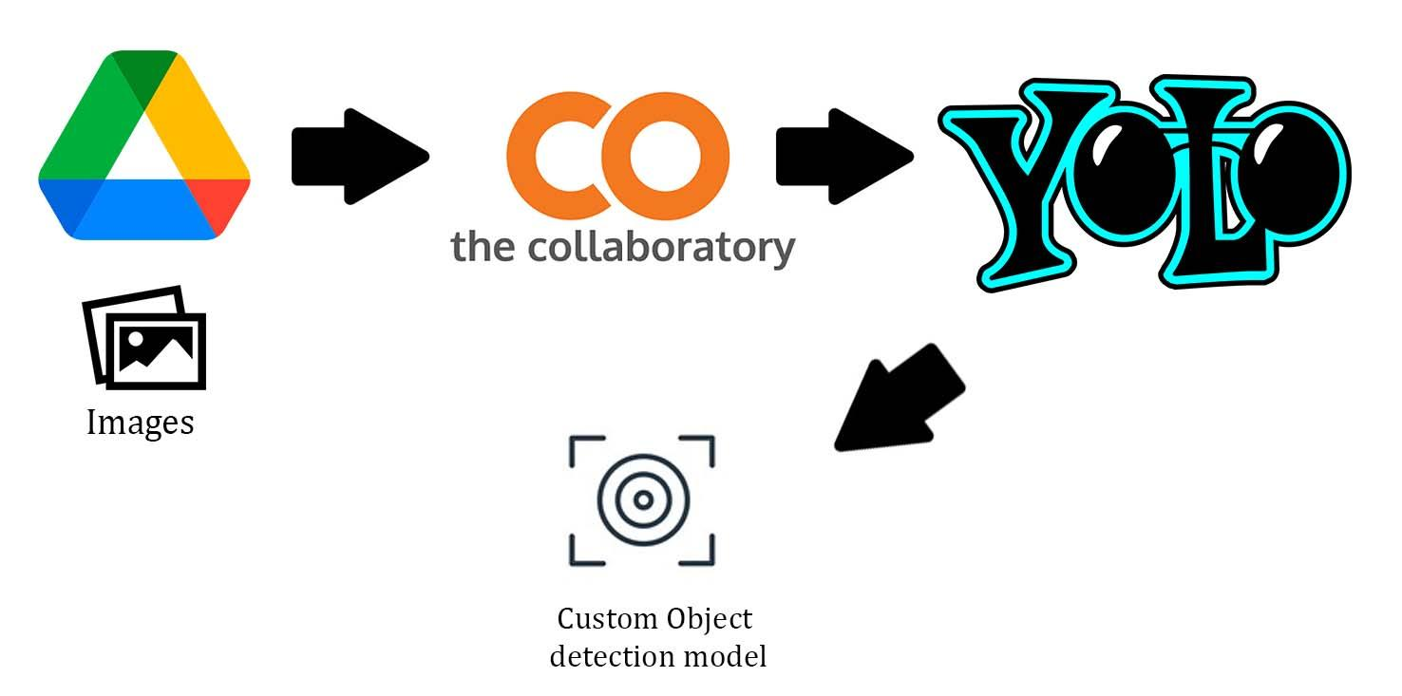
Training YOLOv3
Our proposed method used a state-of-the-art object detection model based on the YOLOv3 algorithm to solve the bib recognition problem.
YOLO uses single regression to detect the target object directly from image pixels by predicting multiple bounding boxes and class probabilities for those boxes. YOLO trains on full images and straight away optimizes detection performance
In phase 1, runner’s racing bibs are detected by using YOLOv3. The overall process of fetching the labeled images to YOLOv3 model is associated with using OpenCV library. By applying the OpenCV library, all the input images are scaled to the same size.
Since any deep learning task requires significant GPU resources, we used Google Colab to train our model. Colab can also access data located in Google Drive easily. The images along with the annotations were stored in google drive and loaded into the Collaboratory.

Slide 9
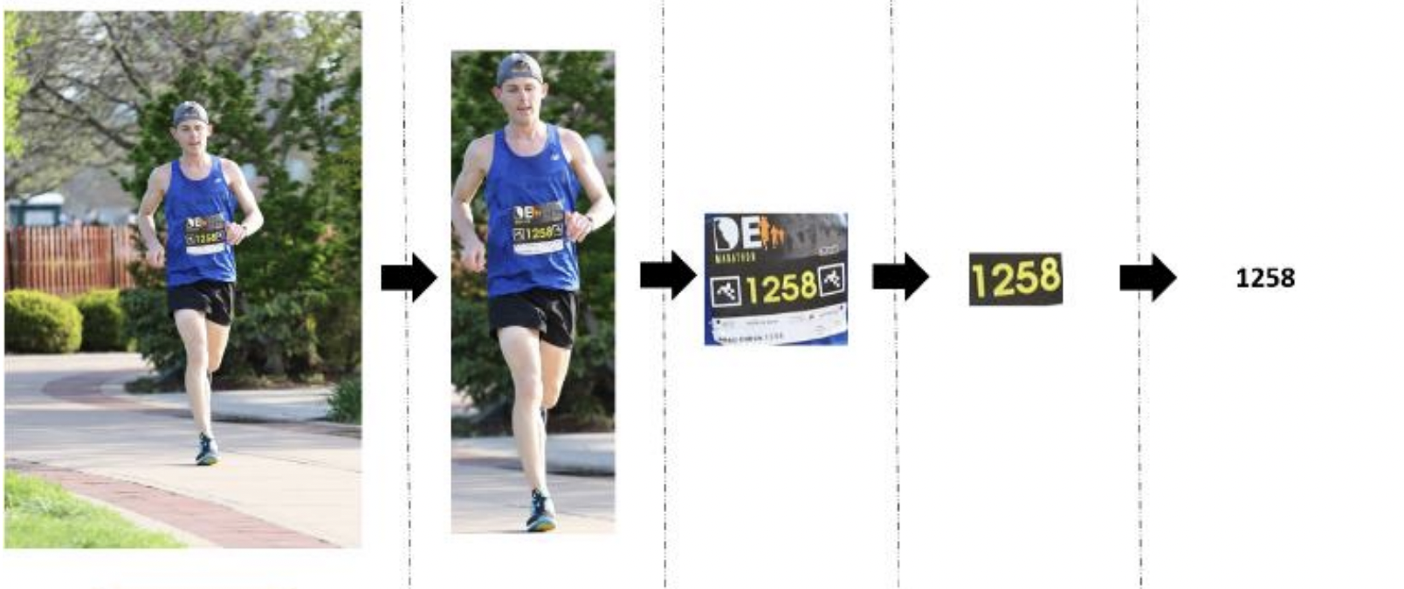
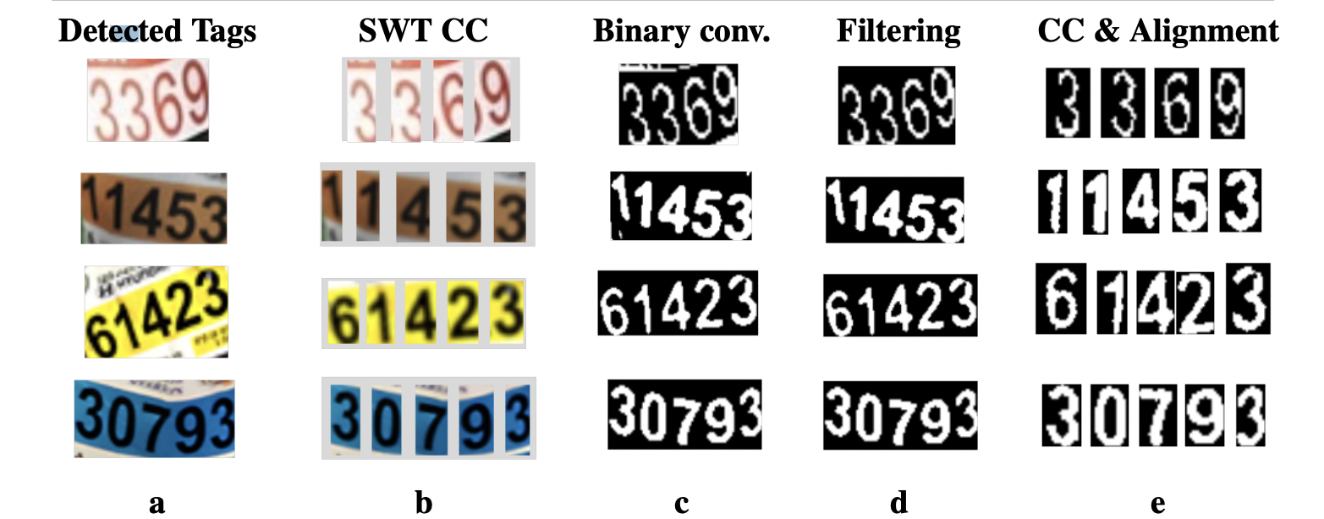
Digit Processing
Next we crop the object detected which is our Bib image and apply optical character recognition (OCR) using Microsoft’s Computer Vision API to convert the image to text. Alternatively, We used Easy OCR (Open Source) was also used in order to generate better extraction values for the images.
The textual data along with the image location is stored in the database, which is displayed to the end-user (typically marathon participants) in a web application upon entering his bib number.

Slide 10
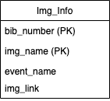
Database and Front End
We used postgres to store the results of the object detection in the table.
The database consists of a single table to store the images, associated bib numbers and the image locations.
A REST endpoint was built using Node.js to fetch the results from the database
The front end was build using React JS and the endpoint was called from here.

Slide 11
Conclusion
In running races, numerous images of runners are captured by running race organizers. This results in that the task of differentiating individual marathon images of a certain runner from all images becomes very troublesome. As a result BibSense solves the problem by employing deep learning-based RBN localization YOLOv3 recognition model.
Network topology implemented in this application is a cascaded network composed of YOLOv3 and Optical Character Recognition (CRNN). YOLOv3 has been used for detecting the runner and bib by forming multiple bounding boxes on an natural set of image collection clicked during event. OCR is later used to recognize the bib number through generating a label sequence for each input image.
We Achieved a Mean Average Precision (mAP) of 81.15% accuracy with exact output of 283 out of 400 after a input of fine-tuned image set.

Slide 12
Current Limitations and Challenges
The recognition could not reach 100% of accuracy because the input images are in the condition of wrinkles or patterns such that sketching or logo surrounding the Bib are accidentally being predicted together with Bib extractions hence affecting the accuracy of cascaded network.
Future Scope
With the demonstrated capability of automating the localization and recognition of racers, the developed system not only could better control large-scale marathon events, but also can tighten the security of racing events.

Slide 13
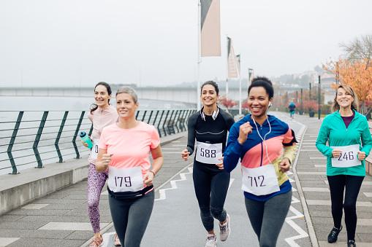
Thank You

